Slide 1




Hexaware CODE&RISE PROGRAM
TECHTITANS_Dhaanish
“Ride Together, Go Further”

Slide 2
Team Details
Team Name :Techtitans_Dhaanish
Application Name : RideShare Application
Team Members
Email ID
M SIVANANTHAN
sivananthan46m@gmail.com
S SHYAM
shyamrocker77@gmail.com
V SWETHA
swethaswe2705@gmail.com
R RAMYA
ramyarv24@gmail.com

Slide 3

Impact/Potential Value of the Application
Cost Reduction
By facilitating ride-sharing among employees, RideShare application aims to lower the overall commuting expenses for each participant.
Employee Connectivity
RideShare application fosters a sense of community by enabling employees to connect and network during their commutes.
Sustainable Commuting
By reducing the number of vehicles on the road, RideShare application contributes to a decrease in carbon emissions and traffic congestion. This aligns with Hexaware's commitment to sustainability and corporate social responsibility.
Safety and Convenience
The application provides a secure platform for ride-sharing, with features such as verified profiles, real-time ride tracking, and AI-driven ride matching to ensure safety and convenience for all users.

Slide 4
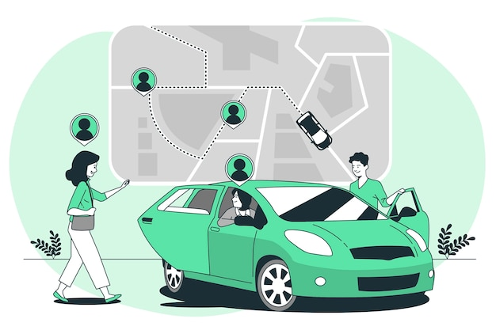
The Solution Proposed by your Team
Solution Highlights
Key Features / Approach
RideShare application is designed to serve Hexaware employees across all locations. The application will support both intra-city and inter-city carpooling. It will be integrated with the company's existing IT infrastructure to facilitate seamless user onboarding and management.
User Authentication
AI-Powered Ride Matching
Flexible Ride Scheduling
Cashless Transactions
Real-Time Notifications

Slide 5
Technologies Used
1. Frontend Development
Framework: React ,HTML,
CSS,JS, Python
4. Database Management
Database: MySql
7. Geolocation Services
Mapping API: Google Maps API
2.Mobile Development
Framework: React Native
5.Cloud Services
Cloud Provider: Amazon Web Services (AWS)
8.Real-Time Communication
Protocol: WebSockets
3. Backend Development
Framework: Node.js
6. Payment Integration
Payment Gateway: Stripe
9.DevOps Tools
CI/CD Tool: GitHub Actions

Slide 6
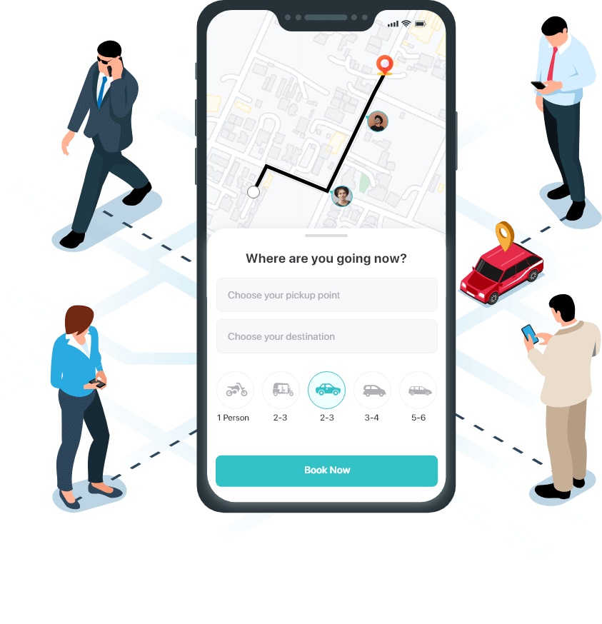
Gen AI Tool Utilization
1.
User Experience Design (UX/UI)
Implement AI to tailor the UI/UX based on user preferences, such as preferred routes, frequent destinations, and visual themes.
Chatbot Integration
Develop an AI-powered chatbot for user support and to answer frequently asked questions.
Data Analysis
Leverage AI for data analysis to gain insights into user behavior and optimize ride matching algorithms.
Route Optimization
Implement AI-powered route optimization algorithms to minimize travel time and distance.
2.
3.
4.

Slide 7
System Architecture, Functionalities and Design Diagram
Rider
Driver
Admin
API Gateway
Authentication Service
Ride Matching Service
Payment
Notification Service
Database

Slide 8
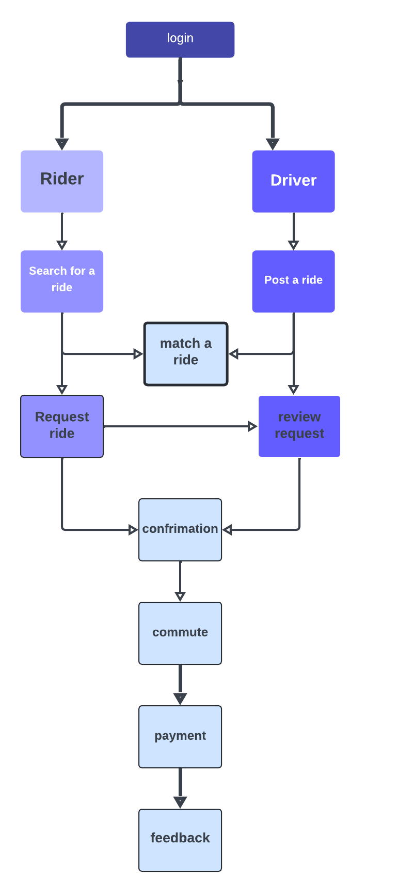
How it works Functional Architecture

Slide 9
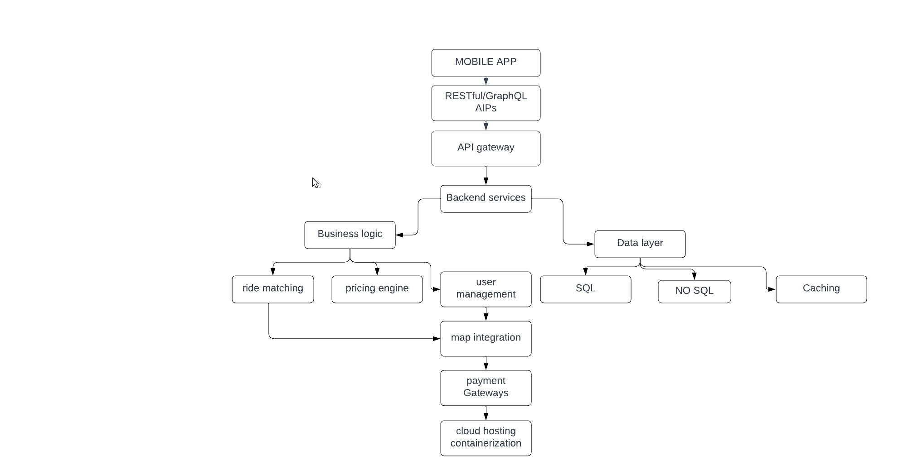
How It Works Technical Architecture

Slide 10
Innovation and Creativity
Innovation
Eco-Friendly Focus: EcoRide connects users with sustainable transportation options, such as electric vehicles (EVs) and hybrid cars, promoting environmentally friendly travel.
Carbon Footprint Tracker: The app features a built-in tracker that calculates and displays the environmental impact of each ride, encouraging users to choose greener options.
Creativity
Multimodal Travel Suggestions: The app integrates local public transport schedules, suggesting multimodal travel options that promote a seamless commuting experience.
Local Business Partnerships: EcoRide partners with local businesses to provide discounts for users who arrive via eco-friendly transportation, creating a win-win for users and the community.

Slide 11
Scalability, Performance and Security
Scalability
The application is designed to scale effortlessly to accommodate a growing number of Hexaware employees, ensuring a smooth and efficient experience for all users.
Performance
RideShare is optimized for swift and reliable performance, ensuring quick ride matching, seamless navigation, and a responsive user interface.
Security
Robust security measures, including encryption, access control, and regular vulnerability assessments, are in place to protect user data and ensure a safe and secure platform.

Slide 12
Best practices and industry standards followed
Security
RideShare adheres to industry-standard security protocols, including encryption, authentication, and authorization, to protect user data and ensure platform integrity.
Privacy
The application complies with relevant privacy regulations, such as GDPR and CCPA, ensuring responsible data handling and user consent.
Accessibility
RideShare is designed to be accessible to all users, regardless of their abilities, by incorporating accessibility features and adhering to relevant standards.
Performance
The application is optimized for speed, reliability, and responsiveness, ensuring a seamless user experience regardless of network conditions.
User Experience
RideShare is designed with a user-centric approach, prioritizing intuitive navigation, clear information, and a visually appealing interface.

Slide 13

Deck Title
“Smart Mobility: The Next Generation of Ridesharing”
Main Idea
Enhance Convenience: Simplify ride booking, real-time tracking, and secure payments.
Promote Sustainability: Reduce traffic congestion and carbon emissions through carpooling.
Ensure Safety: Implement robust safety features, including driver verification and emergency assistance.
Offer Flexibility: Cater to diverse user needs with options for solo rides, carpooling, and scheduled trips.

Slide 14
User Experience
1.
Intuitive Navigation
The application boasts a user-friendly interface with clear menus, intuitive search functions, and helpful prompts, making it easy for employees to navigate and find what they need.
2.
Real-Time Updates
RideShare provides real-time updates on ride availability, driver location, and estimated arrival times, keeping employees informed throughout the journey.
3.
Personalized Preferences
Employees can personalize their preferences, including preferred routes, ride timings, and communication settings, for a more tailored and convenient experience.
4.
Feedback and Support
RideShare offers a feedback mechanism for employees to share their experiences and suggestions, allowing for continuous improvement and support.

Slide 15
Console Output Details
Figma Prototype Link : https://rb.gy/3czkbe
Console Output GitHub Link : MSivananthan/-TECHTITANS_DHAANISH-RideShare-Application (github.com)

Slide 16
Phase 1 - Judging Criteria
Solution Approach
Usage of Gen AI tools
Solution Feasibility
Technical Approach/Architecture Design
Innovation and Creativity
User Experience
Documentation and Presentation
Console Output

Slide 17
Thank You

